Slide 1
Inserm presentation

Slide 2
Inserm is the only public research organization in France entirely dedicated to health.

Slide 3
Our objective: to promote the health of all by advancing knowledge on living organisms and their diseases, and by developing innovation.

Slide 4
Content
Address major biomedical research challenges
Take action to improve the health of all
Disseminate knowledge for the benefit of all
2025 figures, unless otherwise stated

Slide 5
Address major biomedical research challenges

Slide 6



Address major biomedical research challenges
Be a reference in biomedical research
In Europe and worldwide
More than 9,000 copublications with almost 190 international partners in 2024
40 strategic partnership agreements
78 collaboration, projects, networks and platforms over 5 continents
In France
263 research units
50 service units
37 clinical investigation centers
15,832 staff
5,046 civil servants (2,201 researchers, ATIP-Avenir contracts included)
4,172 contract staff and temporary workers (incl. ATIP-Avenir contracts)
> 49 ATIP-Avenir contracts
6,614 teacher-researchers and hospital teachers
An initial budget of €1,335.5 million
€729 million from government subsidies
€606.5 million from internal resources
* in 2026
Patents and licenses
A portfolio of 2,568 patent families
64 new license agreements signed
241 R&D partnerships

Slide 7
Address major biomedical research challenges
Be a reference in biomedical research (2)
In Europe
No. 1 academic applicant in the biomedical sector in Europe
No. 1 European applicant in the pharmaceutical sector
No. 3 European applicant in the biotechnology sector
Horizon Europe since 2021:
ERC: 88 projects, 2^{d} French grant winner
Marie Skłodowska Curie Actions: 54 projects, including 32 coordination
Health Cluster: 88 projects, including 25 coordination, among which Erdera partnership on rare diseases and HERA partnership on emergency preparedness
EIC: 19 projects, including 2 coordination
Infrastructure: participation in 12 projects
Close dialogue
with over 350 patient organizations for
participatory research
meetings and debates between patients and researchers
13,147 original articles
(2024 publications)

Slide 8
Address major biomedical research challenges
Make changes to adapt
2022
2011
1983
Inserm establishes its 2021-2025 Objectives, resources and performance
contract
Inserm establishes
its first Strategic plan and its Objectives and performance contract with the French State
(2011-2015)
Public scientific and technological institute, entirely dedicated to human health and biomedical research
Placed under the joint authority of the French Ministries of Health and Research
2009
Inserm, following reform, ensures the strategic, scientific and operational coordination of biomedical research
Aviesan, the French National Alliance for Life Sciences and Health, is created
1964
2024
2019
Inserm is created
The Health programming agency ran by Inserm is created
Inserm establishes its 2025 Strategic Plan with the French State

Slide 9

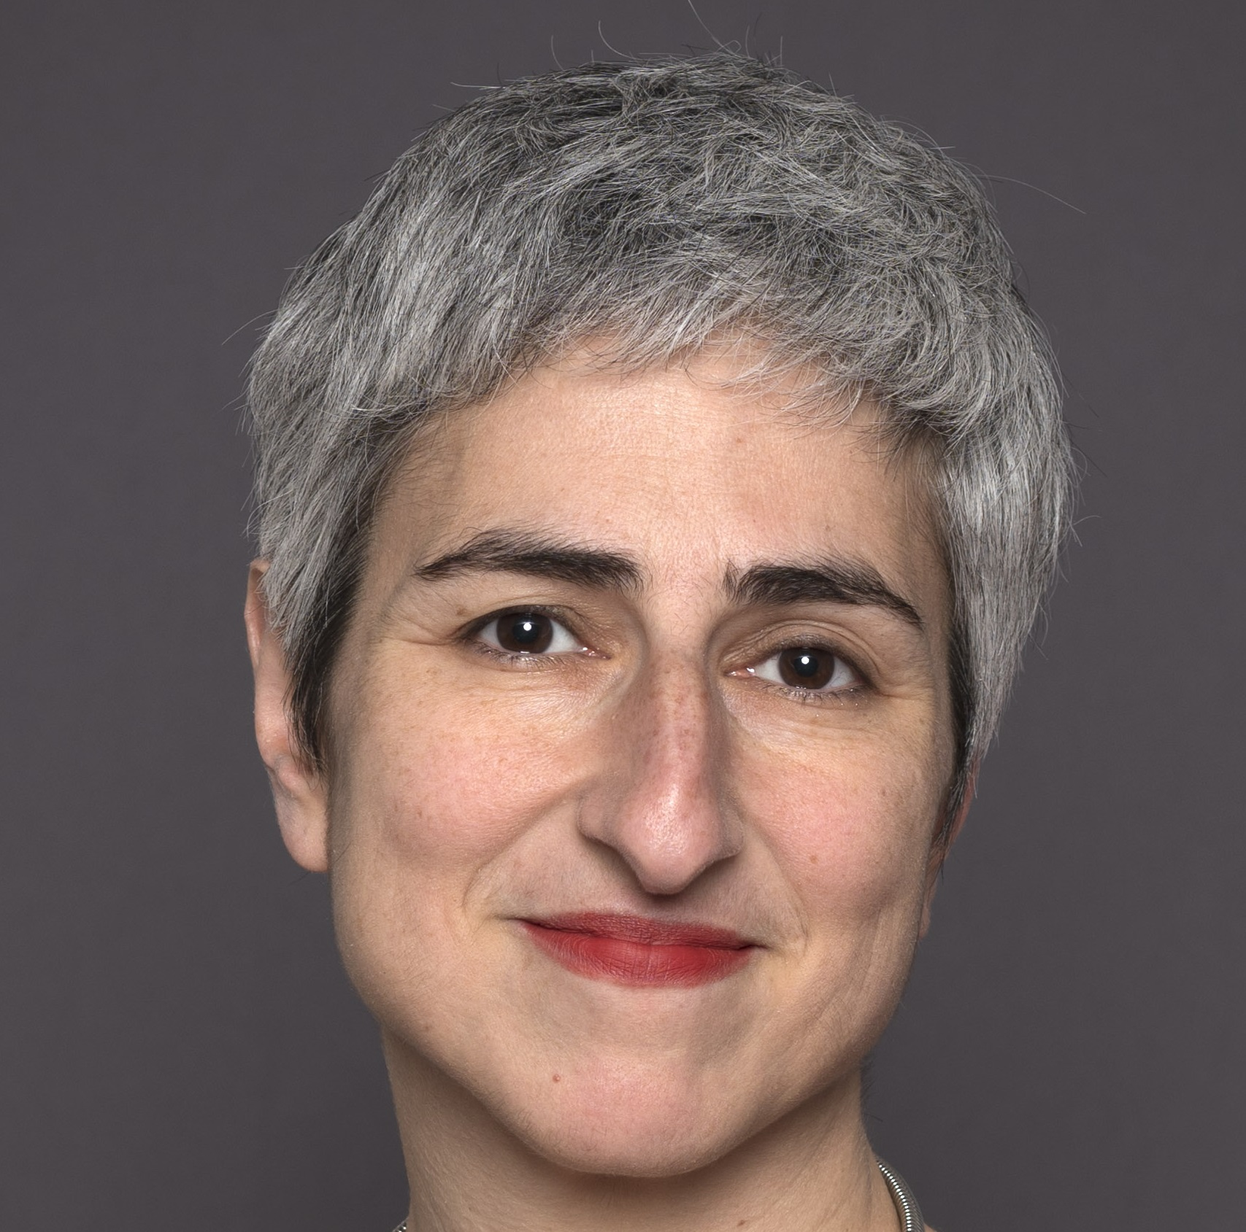


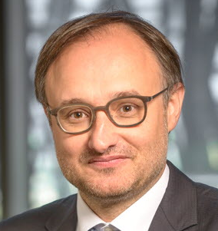
Address major biomedical research challenges
Our organization
Chairman and CEO
Didier Samuel
Professional Ethics Board
Ethics Committee
Ethics Evaluation Committee
Office for Research Integrity
Think Tank Network with Patient Organizations (GRAM)
History Committee
Management Board
Scientific Advisory Board
Specialized Scientific Committees
Research Support Committee
Vice CEO for Strategy
Elli Chatzopoulou
Vice CEO for Administration
Damien Rousset
Executive Director
Carine Delrieu
Executive Director Programming Agency
Franck Mouthon
General Directorate
Thematic institutes
Divisions
Regional Offices
Cancer
Cell biology, development and evolution
Genetics, genomics and bioinformatics
Health Technologies
Immunology, inflammation, infectious diseases and microbiology
Molecular and structural basis of living organisms
Neurosciences, cognitive sciences, neurology, psychiatry
Pathophysiology, metabolism, nutrition
Public health
Communication
Financial Affairs
Human Resources
Information Systems
Legal Affairs
National and Foreign Affairs
Open Science
Program Assessment
Strategic Program
Accounting Department
Auvergne-Rhône-Alpes
Est
Grand Ouest
Île-de-France (4)
Nord-Ouest
Nouvelle-Aquitaine
Occitanie Méditerranée
Occitanie Pyrénées
Provence-Alpes-Côte d’Azur and Corsica

Slide 10
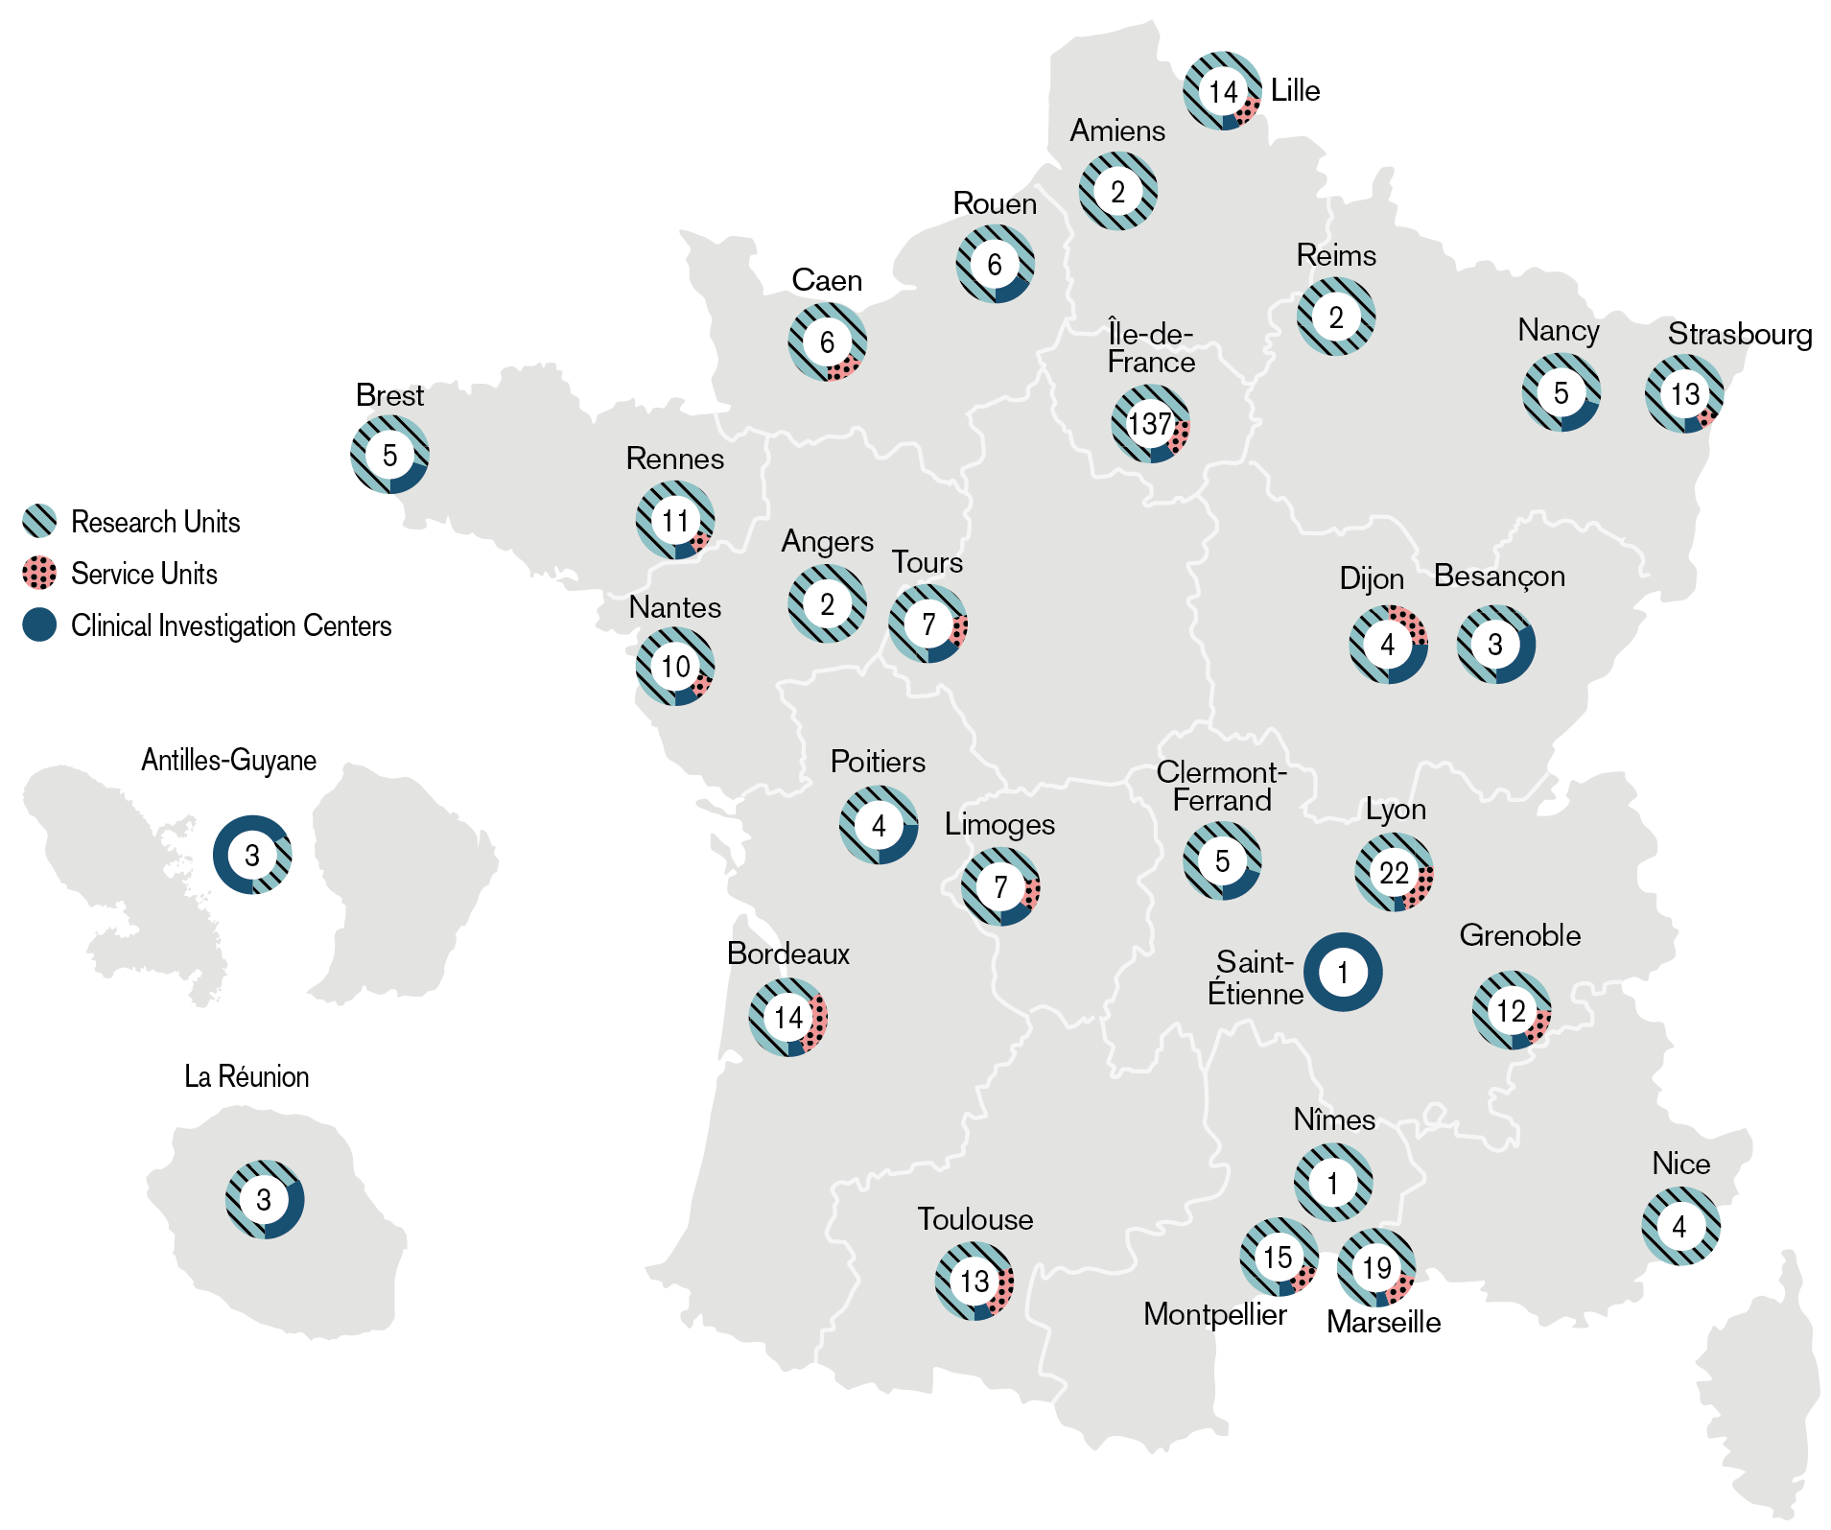
Address major biomedical research challenges
Our presence in France
263
research
units
50
service
units
clinical investigation centers
37

Slide 11
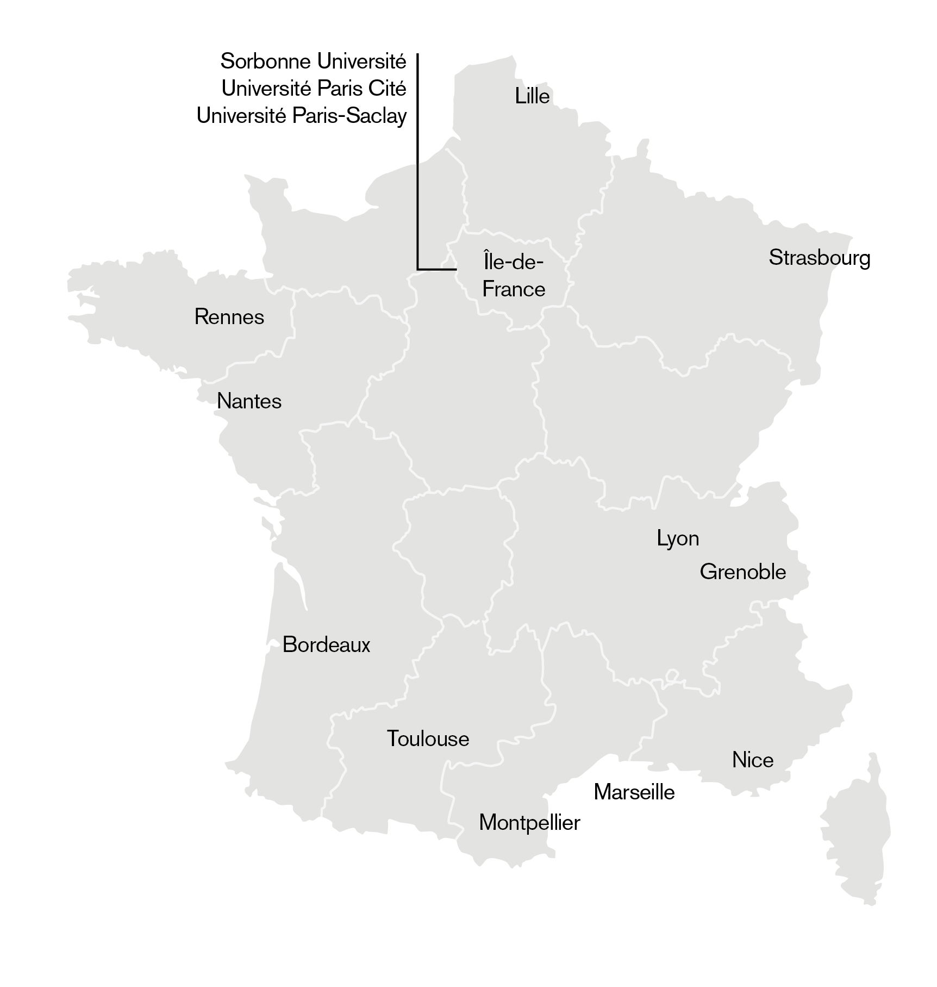
Address major biomedical research challenges
Our presence in France (2)
14
main research universities partner with Inserm

Slide 12
Address major biomedical research challenges
Our main partners in France and abroad
37 universities
A key partner of 14 research universities in which are Idex and I-sites
Research units in 33 teaching hospitals
National research institutions: CNRS / Inrae / Inria / IRD / INED…
French top graduate schools: ENS, ESPCI, EHESS, École polytechnique, EHESP, École des Mines, ENVA…
Industry: Astra Zeneca/MedImmune, MSD Avenir, Sanofi, AdBio Partners…
Foundations and associations: Fondation Bettencourt Schueller, FRM…
European and international academic institutions: Helmholtz, NIH…

Slide 13
Address major biomedical research challenges
Our partner laboratories abroad
Besides the numerous informal scientific collaborations its research teams launch with foreign laboratories over the five continents, Inserm counted in 2025:
40 key international partnerships and joint labs,
3 thematic coordination programs, with 13 partners,
4 international research platforms in global health,
15 first step projects and 54 international research programs,
2 offices abroad
Inserm also works with 9 partner countries through ANRS MIE (Emerging Infectious Diseases).

Slide 14
Take action to improve the health of all

Slide 15
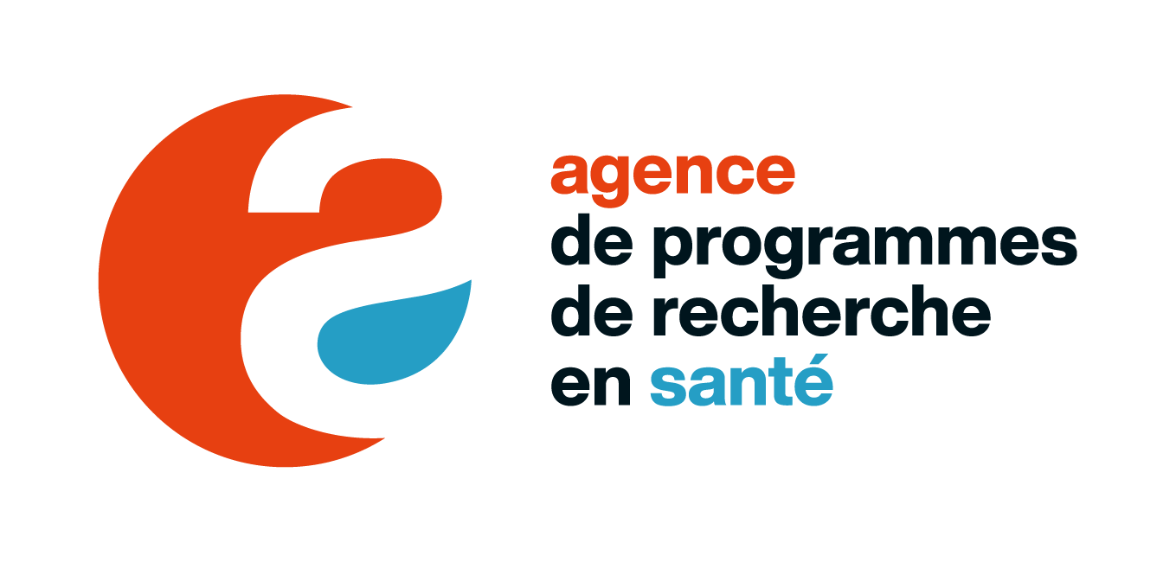
Take action to improve the health of all
Programming and steering national health research
Objectives
To make the research and innovation ecosystem better able to respond to the major challenges and transitions facing the health sector. To achieve this, the Health Research Programming Agency will strengthen coordination between the relevant stakeholders, and help prioritize and define research programs deemed strategic because they have a high societal impact and are of sovereign interest. Once these programs have been approved by the French government, the Agency orchestrates their national management.
Missions
Establish a forward-looking vision to support the induction of innovative and ambitious research programs, based on priority scientific issues in healthcare
Build interdisciplinary expertise in the field of biomedical research
Ensure the coordination between priority programs, with site policies, national and European research infrastructure roadmaps, European initiatives, and across the entire continuum of funding and action in priority areas
Roadmap
Develop three new priority research programs (neurodegenerative diseases, chronic inflammatory diseases, transplantation)
Finalize the France Vaccines program
Manage the research component of the National Acceleration Strategy on Health Prevention
Build an interdisciplinary end-of-life research program
Contribute to national and European roadmaps for research and technological infrastructures and facilities
Develop the Agency's expertise and prospective action

Slide 16
Take action to improve the health of all
Organizing priority health research
Inserm pilots or co-pilots the eight priority health research programs and facilities financed by France 2030, linked to national strategies.
Exploration strategies:
Precision psychiatry (M€80, with CNRS)
Cellular identities and destinies (M€80, with CNRS)
Organs and organoids on chips (M€48.4, with CNRS and CEA)
Acceleration strategies:
Emerging infectious diseases (M€70, with ANRS EID)
Biotherapies and bioproduction of innovative therapies (M€80, with CEA)
Digital health (M€60, with Inria)
Food systems, microbiomes and health (M€58, with INRAE)
Women’s health, couples’ health (M€25)

Slide 17
Take action to improve the health of all
Supporting breakthrough in health research
Inserm leads the national funding program for high-impact, high-risk health research, Impact santé, supported by France 2030.
Objective: identify and provide decisive support for fundamental and applied health research projects that could generate strategic breakthroughs for France over the coming decades, whether in terms of concepts, technologies or methodologies
Budget: M€30 in 2024
Beneficiaries: all health researchers, regardless of affiliation
Missions:
Accompanying and accelerating projects already considered sufficiently mature to produce breakthrough research (maximum M€3 per project)
Detection and seed funding (€150,000 per project) of exploratory projects which, after a maturation phase, are likely to become breakthrough research projects

Slide 18





Take action to improve the health of all
Our missions for health
Produce and disseminate knowledge nationally and internationally
Provide scientific expertise and support for science based policy in health
Play a major role in the national coordination of health research
INITIATE,
DEVELOP AND COORDINATE BIOMEDICAL RESEARCH OF EXCELLENCE
Support higher education and research training
Create value from discoveries and their applications

Slide 19
Take action to improve the health of all
Our fields of activity and expertise
Clinical and preclinical trials
Fundamental research
Cohorts and epidemiological studies
Provision of
expertise and
contribution to
public health and
research policy
Biomedical research infrastructure
Technology
transfer

Slide 20
Take action to improve the health of all
Cohorts and epidemiological studies
EpiCOV
130,000 volunteers for research on SARS-CoV-2
Epidemiologie-France portal
French health database catalogue > epidemiologie-france.aviesan.fr
ELFE
20,000 children born in 2011, longitudinal study from birth to adult age
Major public health expertise and research databases, accessible online
Over 1.6 million people
(2% of the French population) participating
in Inserm cohorts
Constances
220,000 subjects representative of the French population, aged 18 to 69 years on inclusion
+ a biobank of 100,000 subjects
CépiDc Epidemiology center on the medical causes of death > cepidc.inserm.fr
RaDiCo
over 5,000 people with rare diseases in 12 cohorts
Orphanet Portal for rare diseases and orphan drugs > orpha.net
…

Slide 21
Take action to improve the health of all
A continuum from basic to clinical, therapeutic, and public health research
Basic research
Preclinical Studies Proof of concept
Phases I, IIa, IIb, III
Phase IV
National research infrastructures
37 clinical research centers
263 research units
About 90 cohorts & large scale studies

Slide 22
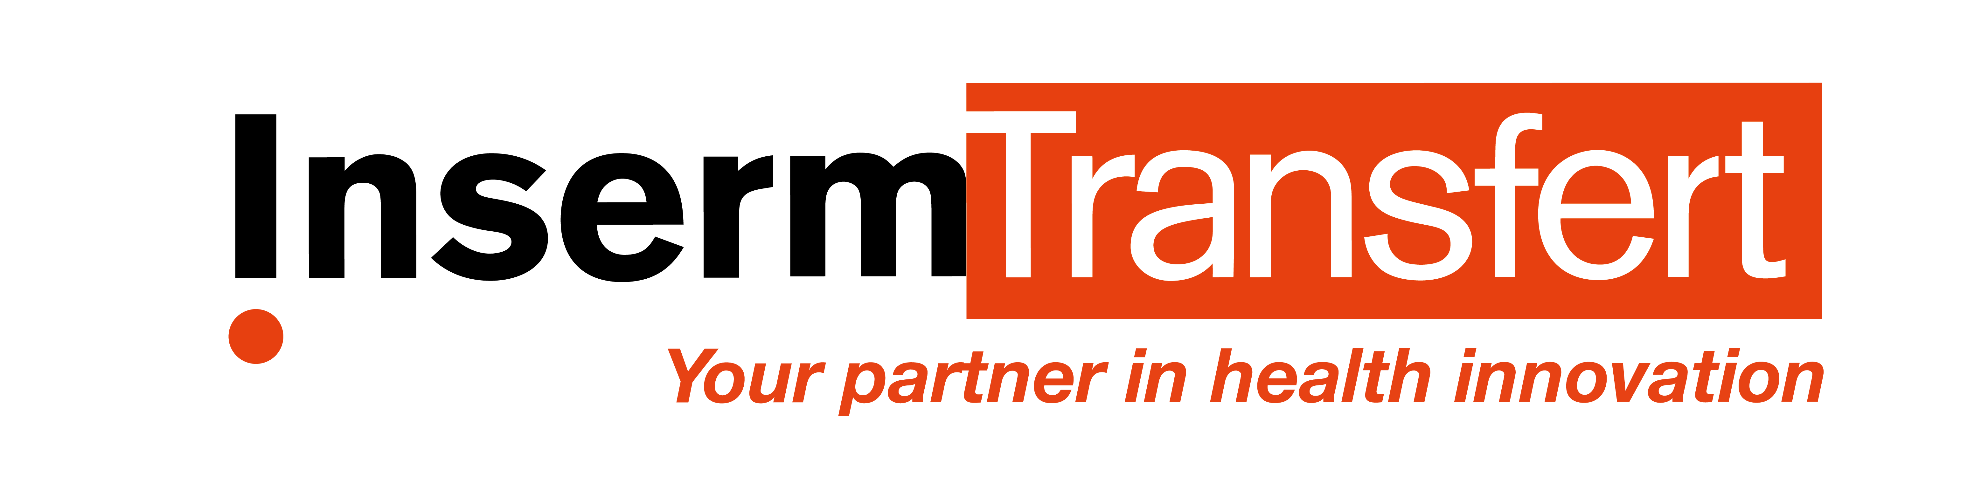
Take action to improve the health of all
Value creation activities which are bearing fruit
2,568 patent family's portfolio
143 new patent families in 2025
An annual budget of €2 M to fund project maturation or proof of concept
A maturation budget reaching €29,4 M invested in 514 projects since 2009
€715 M industrial partnerships since 2006 (research contracts, licenses)
~ €30 M per year from licensing agreements
Over 400 technologies and research tools available for licensing
Strategic alliances with MSDAVENIR, Astra Zeneca/MedImmune, Sanofi, AdBio Partners…
10 startups created each year via Inserm Transfert (Inserm’s subsidiary)
Partnerships with SATTs

Slide 23
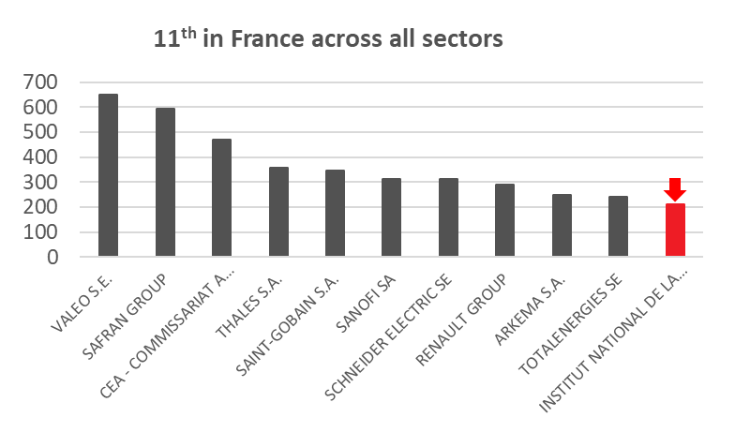
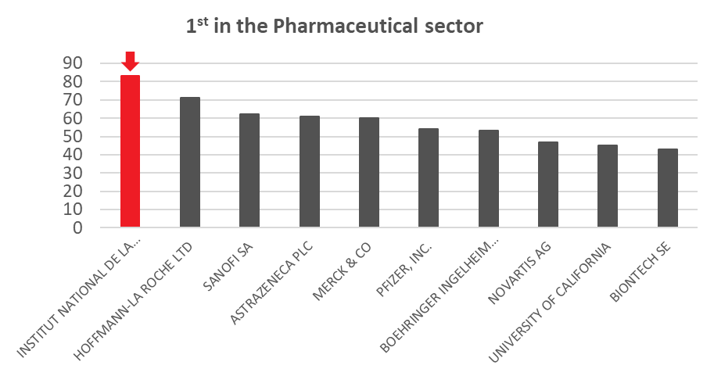
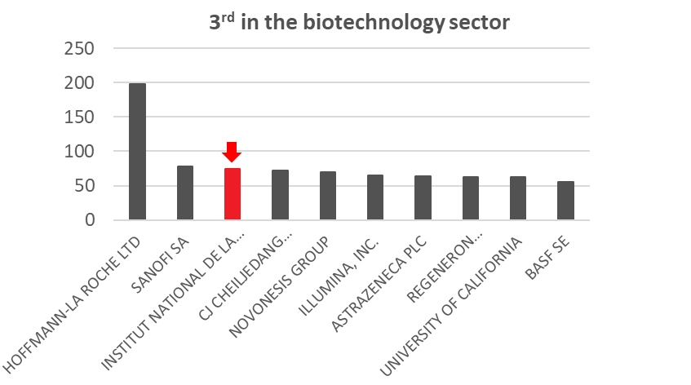
Take action to improve the health of all
Inserm & Inserm Transfert in EPO rankings
No. 1 European applicant in the pharmaceutical sector
No. 3 European applicant in the biotechnology sector
No. 1 European research academic institution in the biomedical sector
2,568 patent families as of 31/12/2025

Slide 24













































Take action to improve the health of all
Inserm Transfert: partnering with industries
A privileged partner of major industrials, mid-size, SME, involved in human health, at the international level, among which:

Slide 25



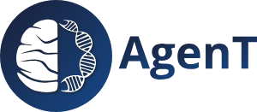

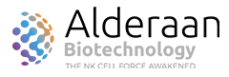















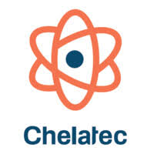














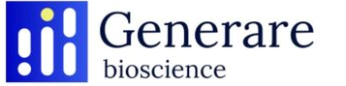




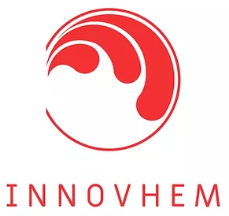








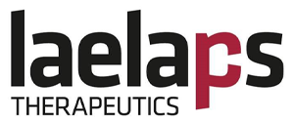





















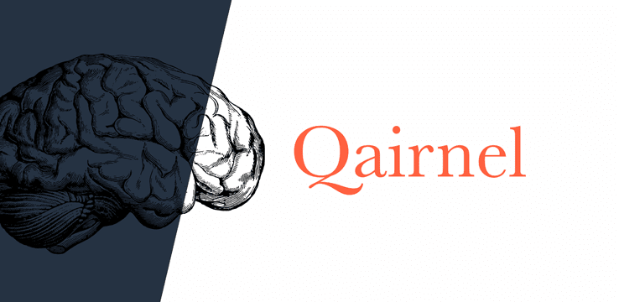











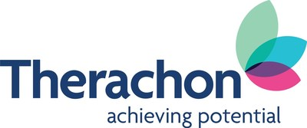








Take action to improve the health of all
Inserm spin-offs based on inventors as drivers

Slide 26
Take action to improve the health of all
Major discoveries
Since its foundation in 1964, Inserm has played a part in many key, historic medical advances, such as:
the first prenatal diagnostic tests;
understanding the HLA system and the ensuing immune reactions;
the first in vitro fertilization;
radiotherapy for cancer;
the first skin graft;
deep brain stimulation in the treatment of Parkinson’s disease;
gene therapy in the treatment many diseases;
innovative technologies like bioprinting, ultrasound, imaging organoids…
the Nutri-Score informing on the nutritional quality of foods

Slide 27
Disseminate knowledge for the benefit of all

Slide 28
Disseminate knowledge for the benefit of all
Our ethics committee to reflect on innovative research and to shed light on debates
Since 1999, Inserm ethics committee has focused on ethical questions in emerging areas of medical innovation
Publication of multiples notes on genome editing and participation in the creation of ARRIGE (Association for Responsible Research and Innovation in Genome Editing) in 2018
Launch in 2022 of Volrethics to define common international ethical rules to protect healthy volunteers in biomedical research and publication of a dedicated global ethics charter, signed in 2025
Think tanks on gender and health research, research on the human embryo, genomic medicine, neurotechnology in education, organoids and organs on chips…

Slide 29

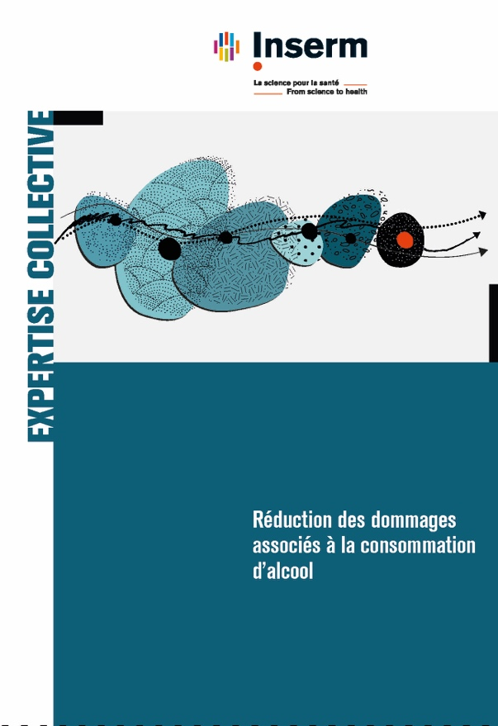
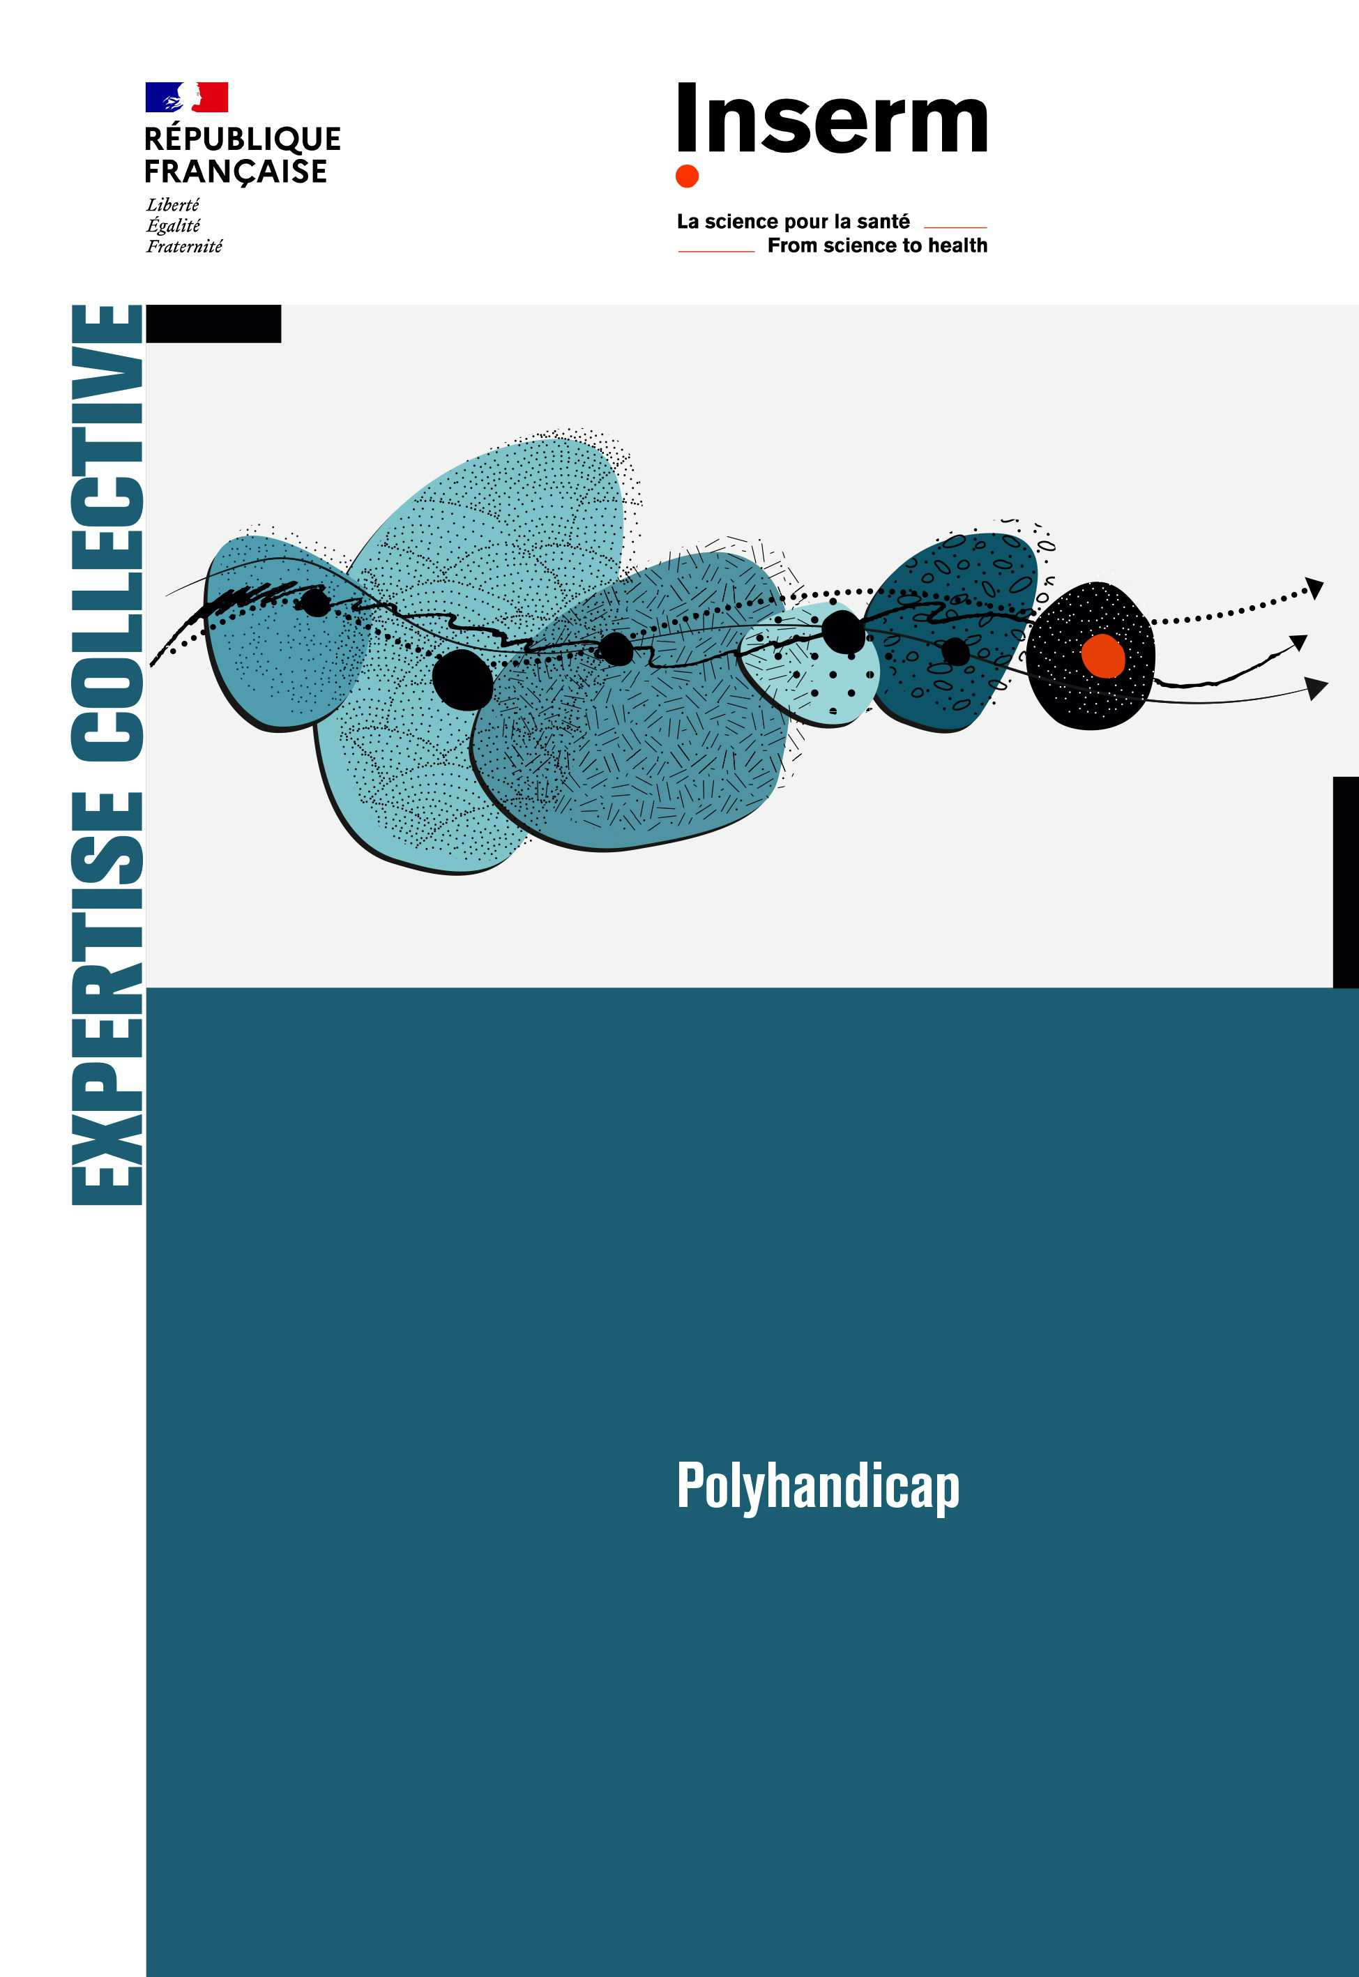
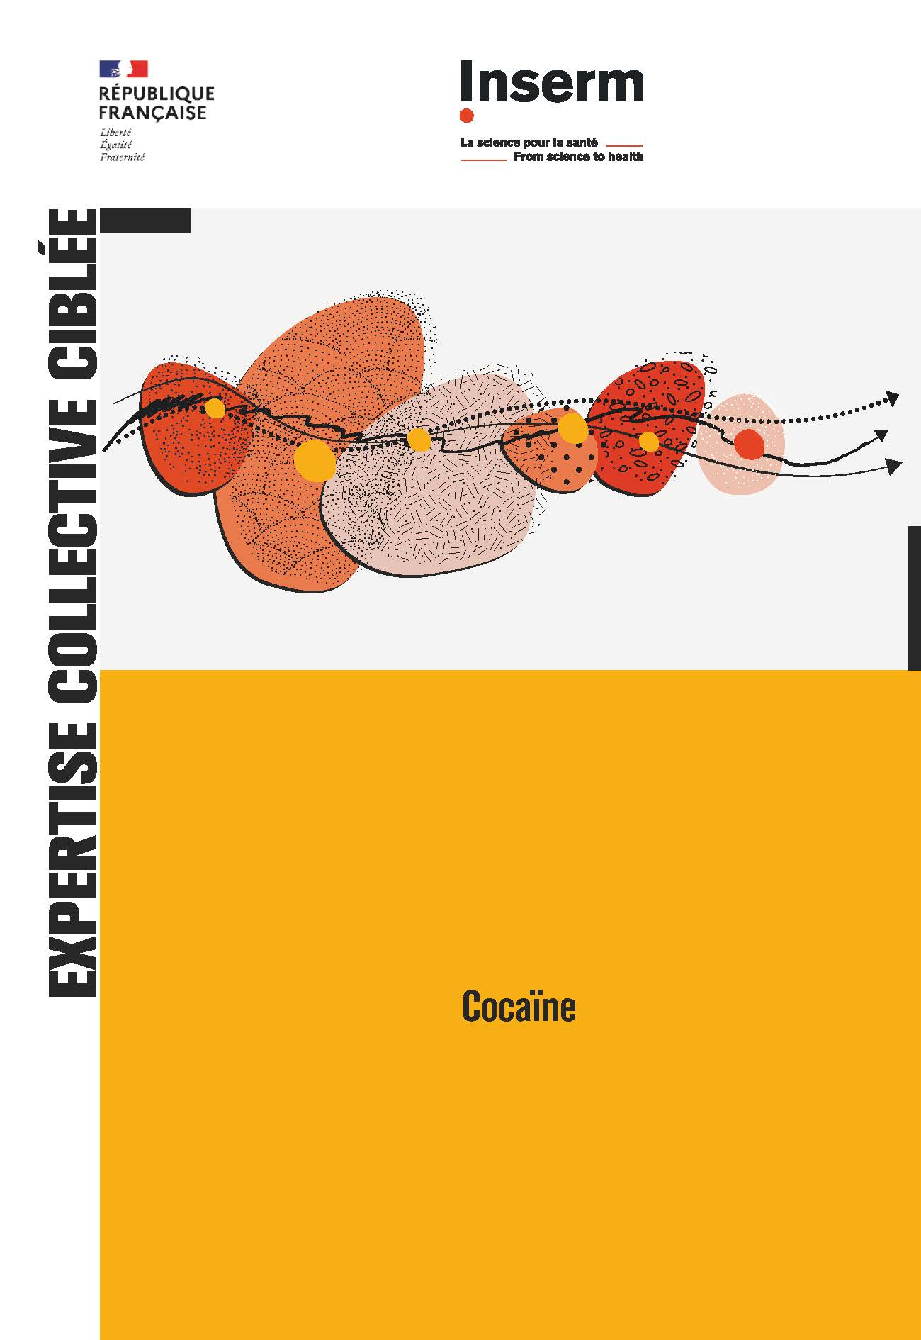
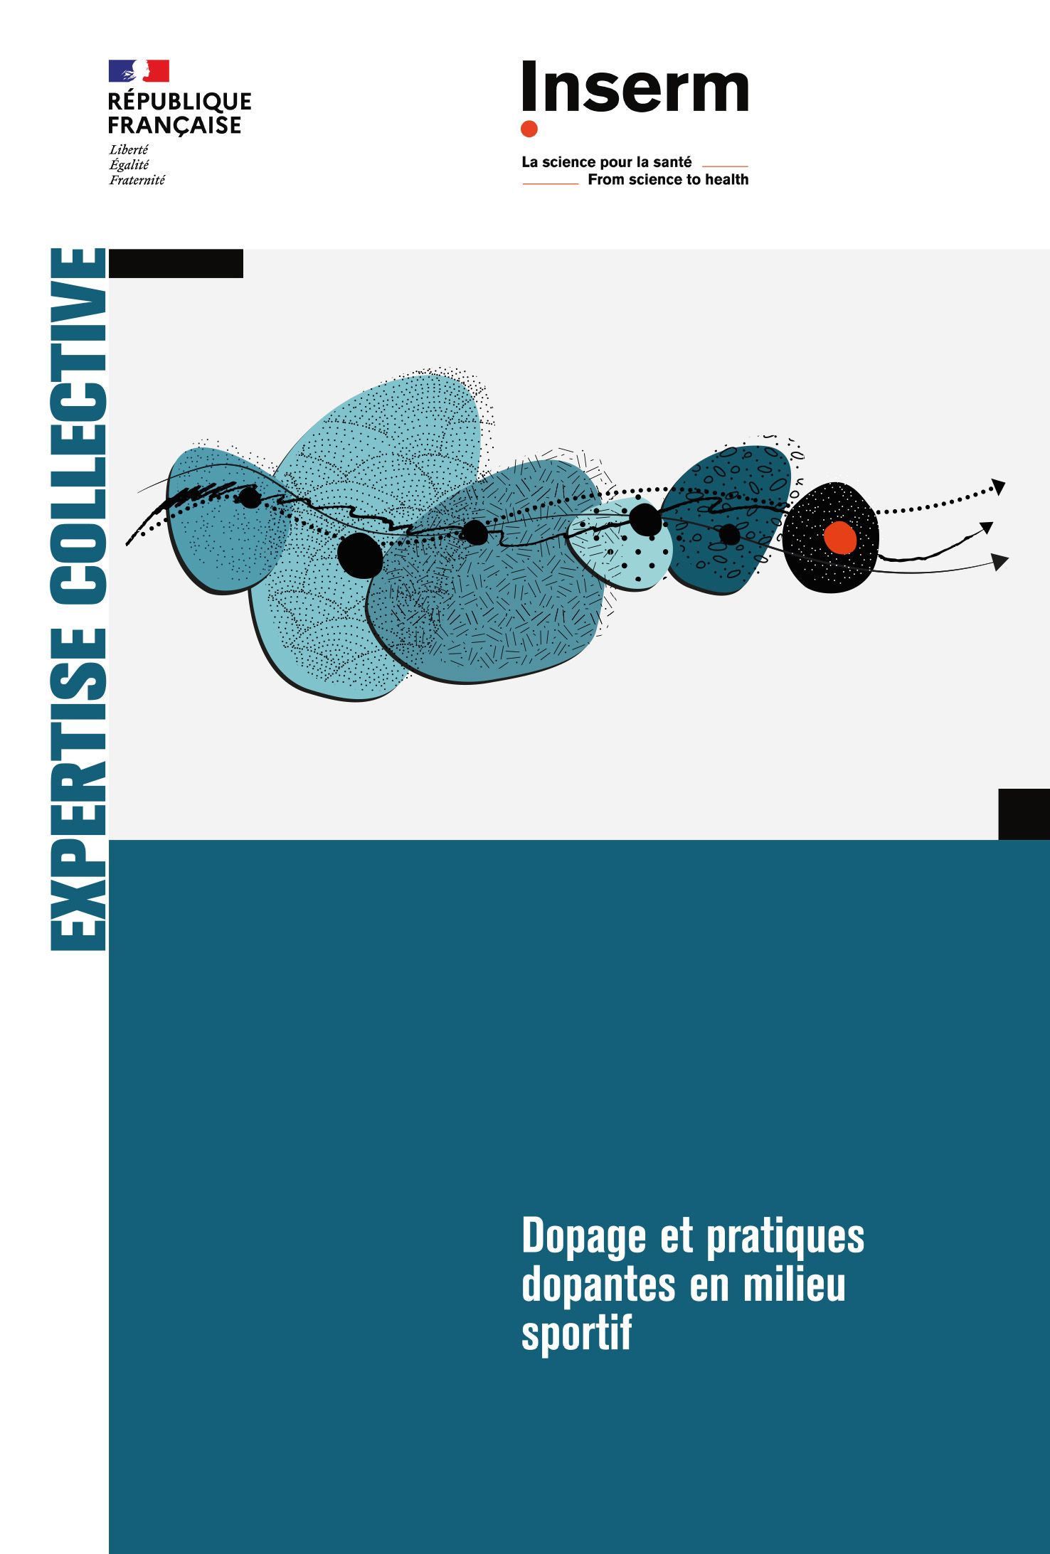
Disseminate knowledge for the benefit of all
Collective expert reviews and contribution to public health policy
Inserm fulfils its mission of expertise provision and knowledge transfer to decision-makers in the field of public health by providing the scientific insight required to take decisions on public health policy issues.

Slide 30
Disseminate knowledge for the benefit of all
Our work with patient organizations
Towards research in partnership with patient organizations and civil society collectives
Promote meetings and direct dialogue between researchers and collectives
Act for the structuring, coordination and animation of participatory research projects
Help to better take into account these projects in the assessment of researchers and structures
Facilitate access to scientific information for society

Slide 31







Disseminate knowledge for the benefit of all
Our presence in the service of public information
inserm.fr
9,100,000
visits
477,500
followers
192,100
followers
53,500
followers
26,900 followers
4,600
followers
28,900
followers
Live lectures and
30’ Santé broadcast
Public events
Meetings and training on participatory research
Canal Détox information videos and articles
1,700,000 participants and views
134,000 views
280 participants
2,200,000 pages viewed

Slide 32
#FromScienceToHealth

