Slide 1
Inserm presentation

Slide 2
Inserm is the only public research organization in France entirely dedicated to health.

Slide 3
Our objective: to promote the health of all by advancing knowledge on living organisms and their diseases, and by developing innovation.

Slide 4
Content
  Address major biomedical research challenges
  Take action to improve the health of all
  Disseminate knowledge for the benefit of all
2023 figures, unless otherwise stated

Slide 5
Address major biomedical
research challenges

Slide 6



Address major biomedical research challenges
Be a reference in biomedical research
      In Europe and worldwide
      7,000 international cooperation agreements with 106 countries
      66 European and international partner laboratories
      35 institutional cooperation agreements
      In France
      278 research units
      34 clinical investigation centers
      48 service units
      15,234 staff
      4,972 civil servants
      (2,180 researchers, ATIP-Avenir contracts included)
      3,719 contract staff and temporary workers (incl. ATIP-Avenir contracts)
      > 50 ATIP-Avenir contracts
      6,534 teacher-researchers and hospital teachers
      An initial budget of
      €1,176 million
      €719,4 million from government subsidies
      and €456,6 million from internal resources
      * in 2024
      Patents and licenses
      A portfolio of 2,492 patent families
      131 new license agreements signed
      306 R&D partnerships

Slide 7
Address major biomedical research challenges
Be a reference in biomedical research (2)
      In Europe
      No. 1 academic applicant in the biomedical
      sector in Europe
      No. 2 European applicant in the biotechnology
      sector
      No. 5 European applicant in the pharmaceutical
      sector
      Horizon Europe launch and 2021 results:
      ERC: 57 projects, 2^{d} French ERC grant winner
      Marie Skłodowska Curie Actions: 9 individual grants, 11 doctoral networks, including 2 coordinations
      Health Cluster: 54 projects, including 13 coordinations
      EIC: 16 projects, including 2 coordination
      Infrastructure: participation in 6 projects
      Horizon 2020 results:
      1st coordinator of the Health societal challenge
      396 contracts, incl. 83 grant winners and 53 Marie Skłodowska-Curie grants
      Close dialogue
      with over 500 patient organizations for
      participatory research
      meetings and debates between patients and researchers
      10,976 original articles
      (publications 2022)

Slide 8
Address major biomedical research challenges
Make changes to adapt
2022
2011
1983
      Inserm
      establishes its
      2021-2025 Objectives, resources and performance
      contract
      Inserm establishes
      its first Strategic plan and its Objectives and performance contract with the French State
      (2011-2015)
      Public scientific and technological institute, entirely dedicated to human health and biomedical research
      Placed under the joint authority of the French Ministries of Health and Research
2009
      Inserm, following reform, ensures the strategic, scientific and operational coordination of biomedical research
      Aviesan, the French National Alliance for Life Sciences and Health, is created
1964
2024
2019
      Inserm is created
      The Health programming agency ran by Inserm is created
      Inserm establishes its 2025 Strategic Plan with the French State

Slide 9

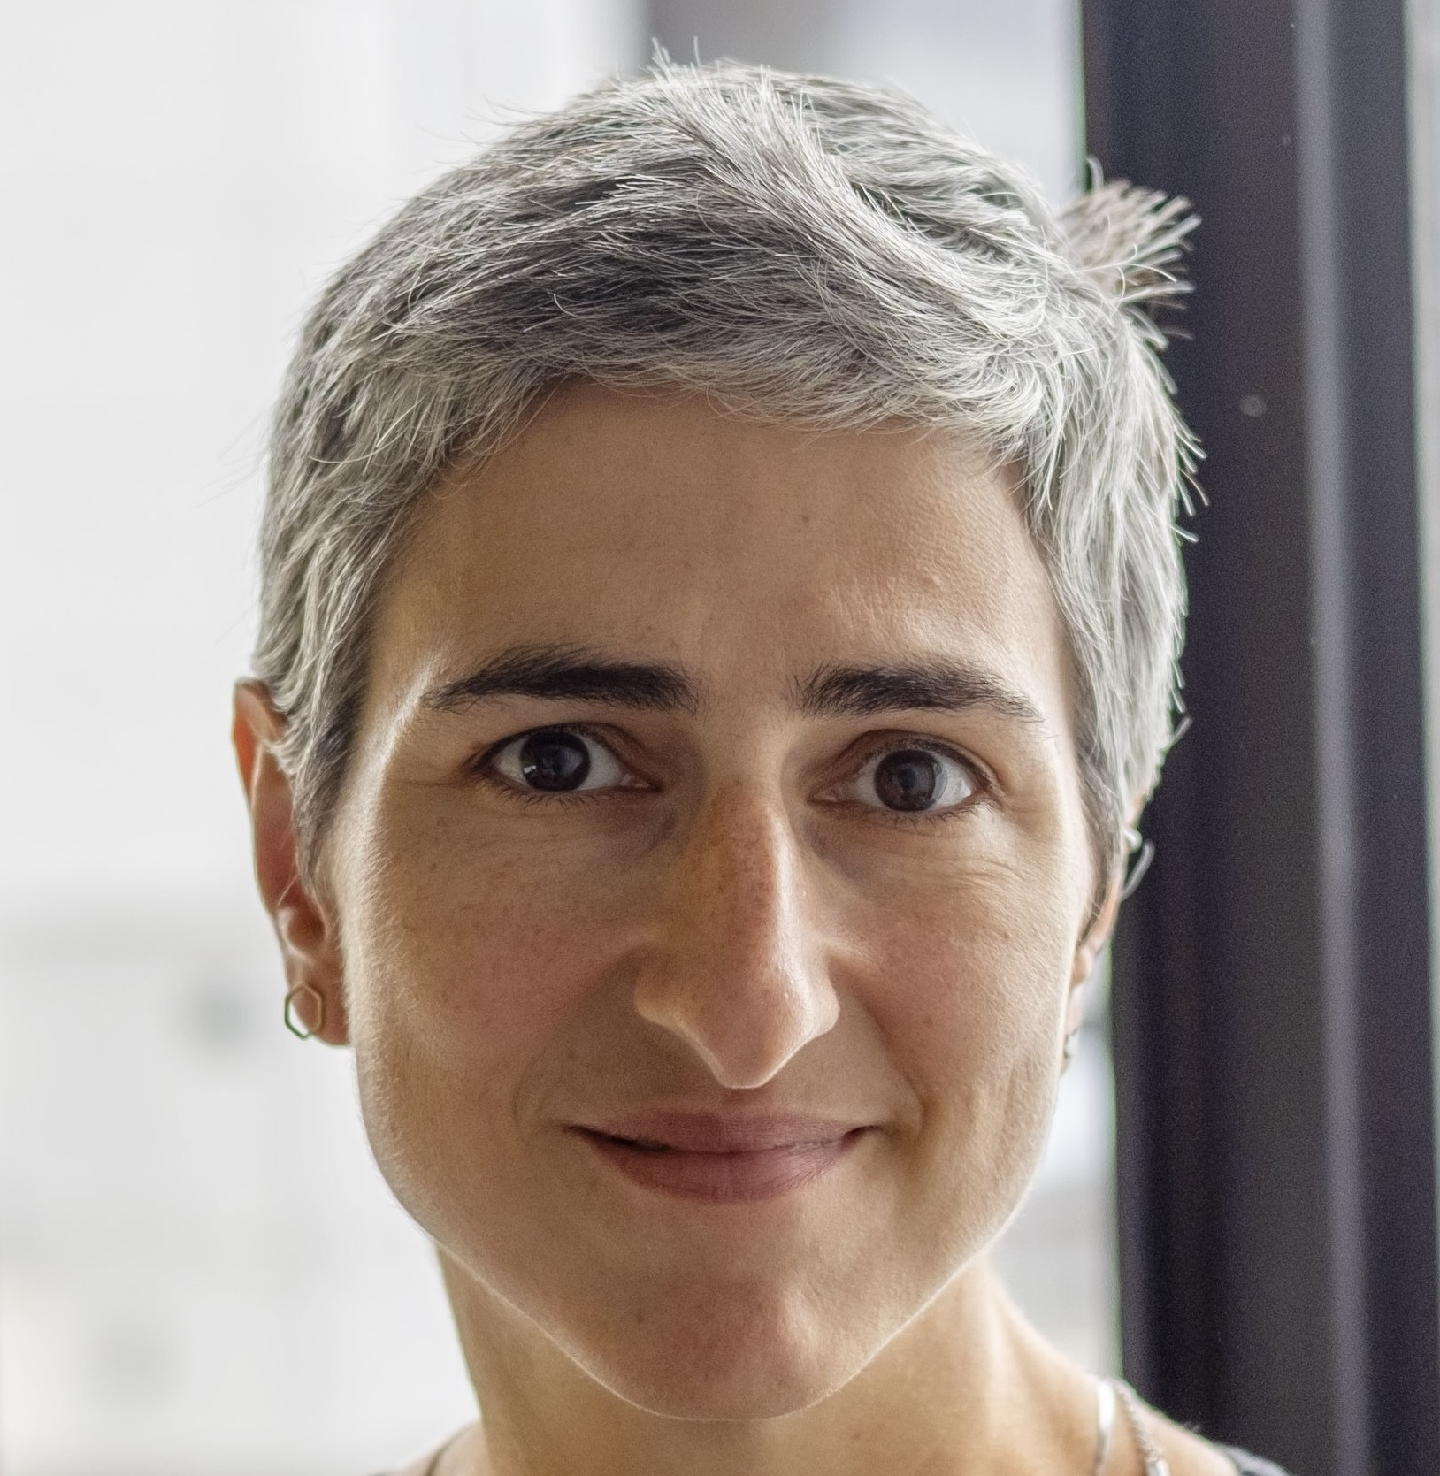
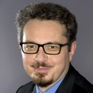

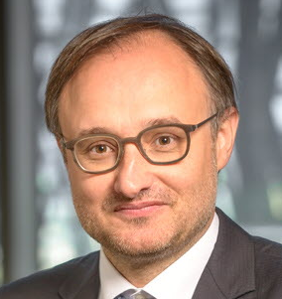
Address major biomedical research challenges
Our organization
Chairman and CEO
Didier Samuel
        Professional Ethics Board
        Ethics Committee
        Ethics Evaluation Committee
        Office for Research Integrity
        Think Tank Network with Patient Organizations (GRAM)
        History Committee
Management Board
Scientific Advisory Board
Specialized Scientific Committees
Research Support Committee
Vice CEO
for Strategy
Elli Chatzopoulou
Vice CEO
for Administration
Damien Rousset
Executive Director
Carine Delrieu
Executive Director
Programming Agency
Franck Mouthon
General Directorate
Thematic institutes
Divisions
Regional Offices
Cancer
Cell biology, development and evolution
Genetics, genomics and bioinformatics
Health Technologies
Immunology, inflammation, infectious diseases and microbiology
Molecular and structural basis of living organisms
Neurosciences, cognitive sciences, neurology, psychiatry
Pathophysiology, metabolism, nutrition
Public health
Communication
Financial Affairs
Human Resources
Information Systems
Legal Affairs
National and Foreign Affairs
Open Science
Program Assessment
Strategic Program
Accounting Department
Auvergne-Rhône-Alpes
Est
Grand Ouest
Île-de-France (4)
Nord-Ouest
Nouvelle-Aquitaine
Occitanie Méditerranée
Occitanie Pyrénées
Provence-Alpes-Côte d’Azur and Corsica

Slide 10
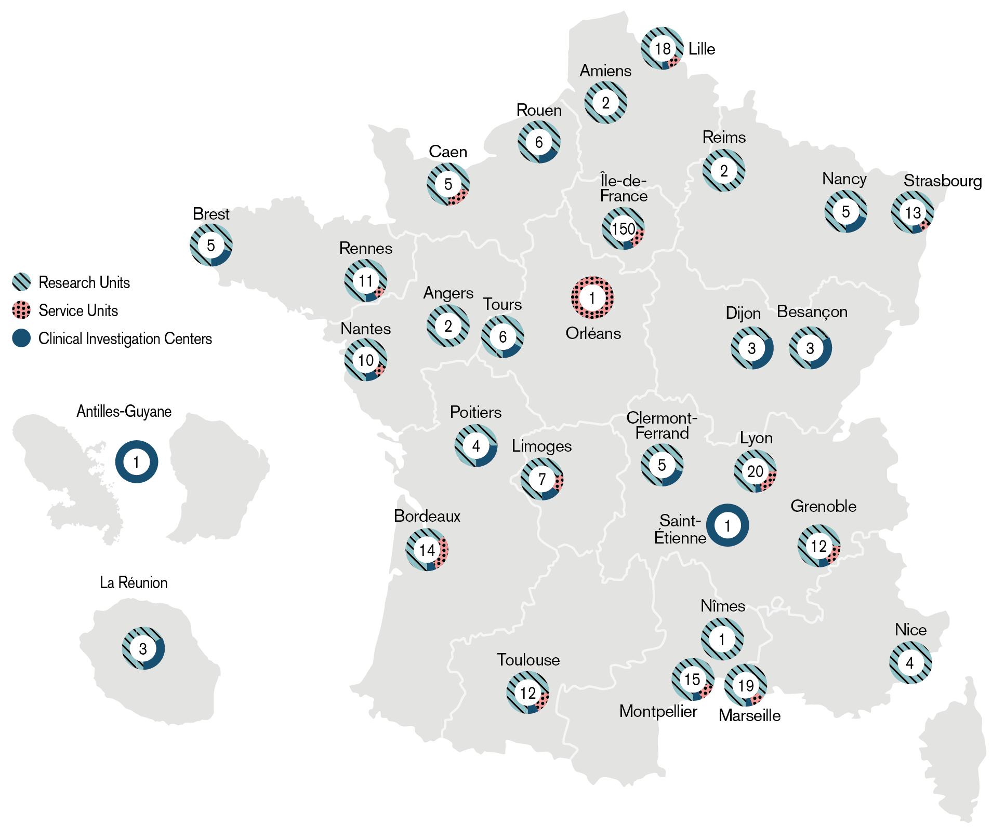
Address major biomedical research challenges
Our presence in France
      278
research
units
      48
service
units
      clinical investigation centers
      34

Slide 11
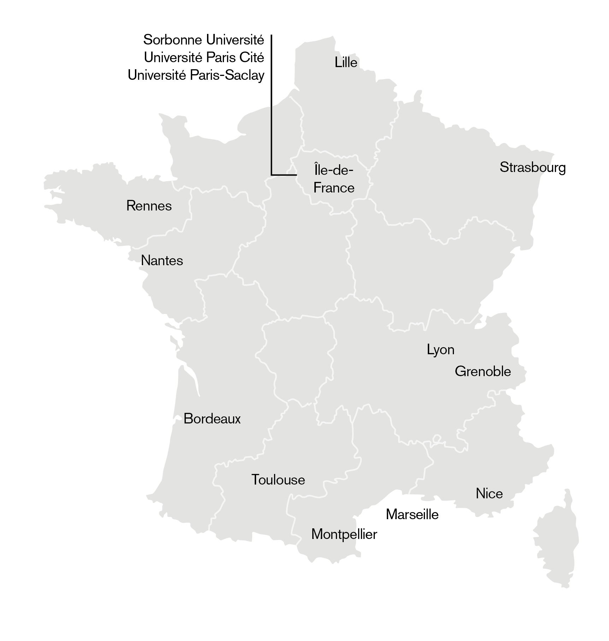
Address major biomedical research challenges
Our presence in France (2)
      85%
      of Inserm
      Strengths in…
research universities,
in which Inserm
invests more than €10M each year
      14

Slide 12
Address major biomedical research challenges
Our main partners in France and abroad
  37 universities
  A key partner of 14 research universities in which Inserm invests more than €10M each year
  On 14 Idex and I-sites, Inserm invests 72%
  of its resources
  Research units in 31 teaching hospitals
  National research institutions: CNRS / Inrae / Inria / IRD / INED…
  French top graduate schools: ENS, ESPCI, EHESS, École polytechnique, EHESP, École des Mines, ENVA…
  Industry: Astra Zeneca/MedImmune, MSD Avenir, Sanofi, AdBio Partners…
  Foundations and associations: Fondation Bettencourt Schueller, FRM…
  European and international academic institutions: Helmholtz, NIH…

Slide 13
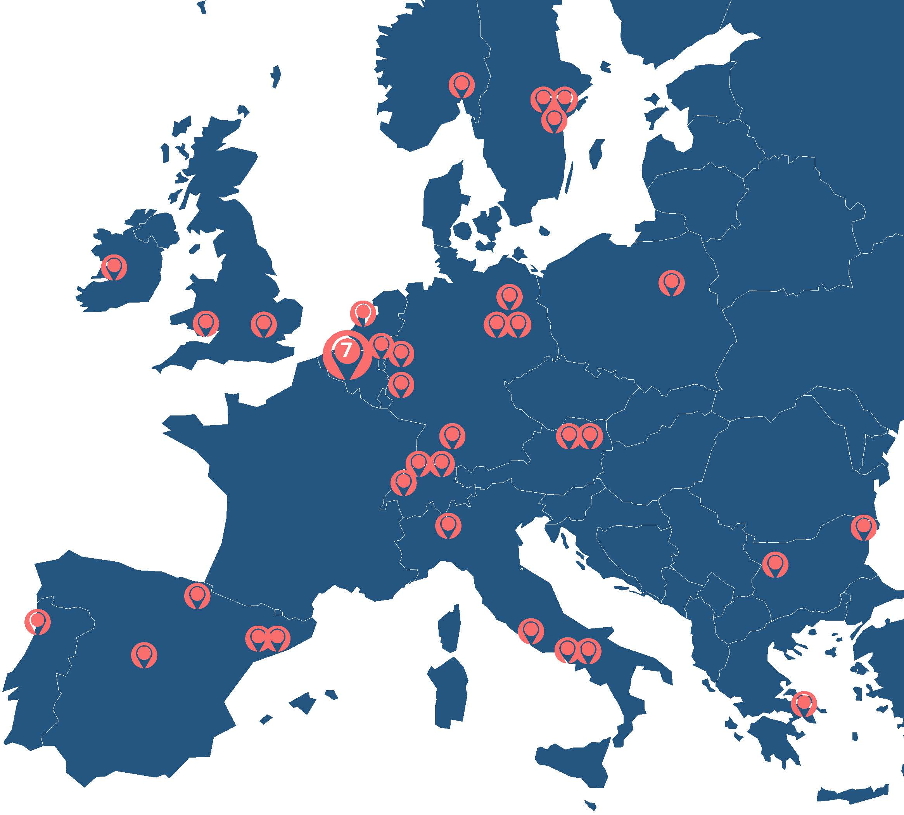
Address major biomedical research challenges
Our partner laboratories in Europe
Inserm research teams launch many informal scientific collaborations with European laboratories.
In addition to these spontaneous cooperation networks, Inserm signed, in 2024, 40 partnership agreements in Europe thanks to dedicated instruments: thematic coordination programs, international research projects and first step projects.
Notes:
Si ce que nous voulons est un état des lieux début 2024
1. FIRST STEP
Appel 2023 en cours en 2024 : 15 nouveaux FS
Les 8 nouveaux First step 2024 Europe
Espagne (3) : 2 à Barcelone, Valencia ; ITALIE (2) Rome et Monza ; ALLEMAGNE (2) : Neuherberg, Leipzig ; SUEDE : Uppsala
Les 7 nouveaux First step 2024 International : ETATS UNIS (5) : New york, Boston, Chicago, Irvine, Standford ; CHINE : Beijin ; ARGENTINE : Buenos Aires
=> et supprimer les tremplins qui sont actuellement sur la carte car leur durée est un an).
2. Pour les IRP
ajouter les 12 IRP de l’appel 2022 à savoir :
AUSTRALIE Melbourne + NOUVELLE-ZÉLANDE Christchurch (2 partenaires étrangers) ; BRÉSIL Sao Paulo ; ITALIE Naples ; CANADA MONTREAL; INDE Bangalore ; ESPAGNE Pamplona, Navarra ; ESPAGNE Madrid ; BÉNIN Abomey-Calavi ; CAMEROUN Yaoundé ; CANADA Montréal ; BULGARIE Sofia + Varna (2 partenaires étrangers) ; MONGOLIE Ulaanbaatar
+
Ceux de l’ Appel 2023 qui vont démarrer en 2024 : 15 nouveaux IRP au total
Les 9 Européens : => Irlande : Limerick ; BELGIQUE (2) : Bruxelles et Namur ; AUTRICHE : Vienne ; SUISSE : Bâles ; ITALIE : Naples ; ALLEMAGNE : Leipzig ; POLOGNE : Varsovie ; SUEDE : Stockholm
Les 6 hors Europe : => Australie : Melbourne ; TAIWAN : Taipei ; INDE : New Dehli ; CHINE : Wuhan ; JAPON : Yokohama ; BRESIL : Belo Horizonte
IRN : + changer la légende pour Réseau de recherche (supprimer la ligne « réseau de recherche international » mais conserver les 2 points qui ont été labellisés IRP au sens de l’Inserm – mais un IRN CNRS nb. Planegg en Allemagne et Nottingham en UK et Huazhong en Chine
PCT: supprimer Zurich et ajouter Oslo

Slide 14
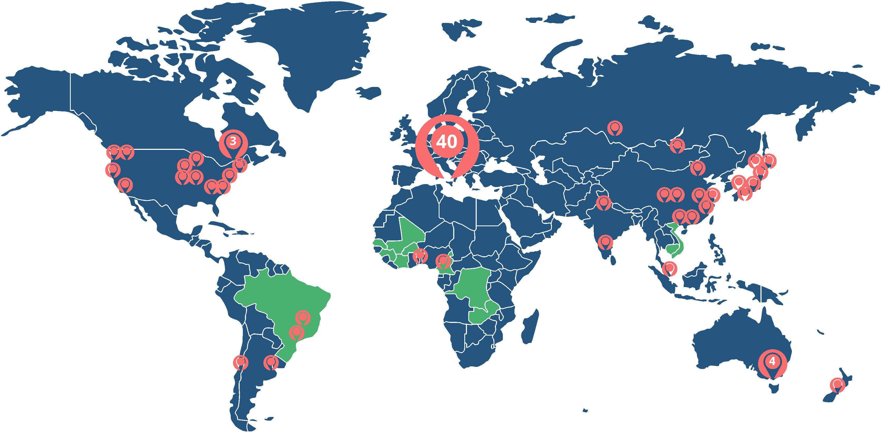
Address major biomedical research challenges
Our partner laboratories abroad
Inserm research teams launch many informal scientific collaborations with European laboratories.
In addition to these spontaneous cooperation networks, Inserm signed, in 2024, 85 partnership agreements worldwide thanks to dedicated instruments: thematic coordination programs, international research projects and first step projects.
Besides, Inserm is working with 11 partner countries through ANRS MIE.
Notes:
Si ce que nous voulons est un état des lieux début 2024
1. FIRST STEP
Appel 2023 en cours en 2024 : 15 nouveaux FS
Les 8 nouveaux First step 2024 Europe
Espagne (3) : 2 à Barcelone, Valencia ; ITALIE (2) Rome et Monza ; ALLEMAGNE (2) : Neuherberg, Leipzig ; SUEDE : Uppsala
Les 7 nouveaux First step 2024 International : ETATS UNIS (5) : New york, Boston, Chicago, Irvine, Standford ; CHINE : Beijin ; ARGENTINE : Buenos Aires
=> et supprimer les tremplins qui sont actuellement sur la carte car leur durée est un an).
2. Pour les IRP
ajouter les 12 IRP de l’appel 2022 à savoir :
AUSTRALIE Melbourne + NOUVELLE-ZÉLANDE Christchurch (2 partenaires étrangers) ; BRÉSIL Sao Paulo ; ITALIE Naples ; CANADA MONTREAL; INDE Bangalore ; ESPAGNE Pamplona, Navarra ; ESPAGNE Madrid ; BÉNIN Abomey-Calavi ; CAMEROUN Yaoundé ; CANADA Montréal ; BULGARIE Sofia + Varna (2 partenaires étrangers) ; MONGOLIE Ulaanbaatar
+
Ceux de l’ Appel 2023 qui vont démarrer en 2024 : 15 nouveaux IRP au total
Les 9 Européens : => Irlande : Limerick ; BELGIQUE (2) : Bruxelles et Namur ; AUTRICHE : Vienne ; SUISSE : Bâles ; ITALIE : Naples ; ALLEMAGNE : Leipzig ; POLOGNE : Varsovie ; SUEDE : Stockholm
Les 6 hors Europe : => Australie : Melbourne ; TAIWAN : Taipei ; INDE : New Dehli ; CHINE : Wuhan ; JAPON : Yokohama ; BRESIL : Belo Horizonte
IRN : + changer la légende pour Réseau de recherche (supprimer la ligne « réseau de recherche international » mais conserver les 2 points qui ont été labellisés IRP au sens de l’Inserm – mais un IRN CNRS nb. Planegg en Allemagne et Nottingham en UK et Huazhong en Chine
PCT: supprimer Zurich et ajouter Oslo

Slide 15
Take action to improve the health of all

Slide 16
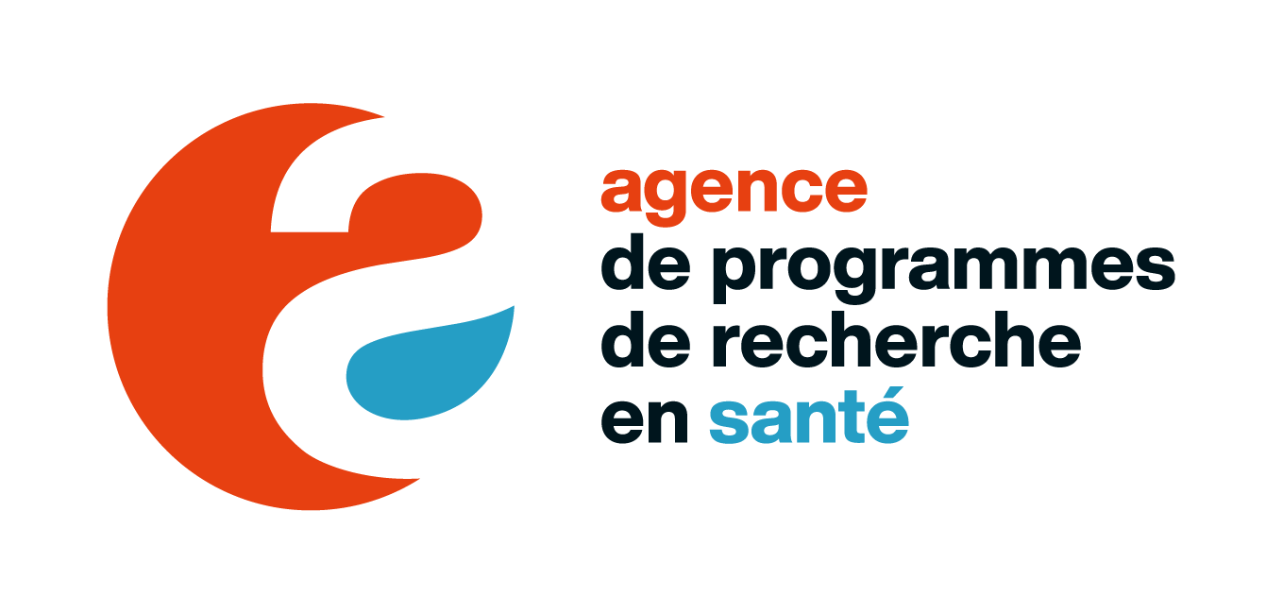
Agir pour améliorer la santé de tous
Programming and steering national health research
      Objectives
      To make the research and innovation ecosystem better able to respond to the major challenges and transitions facing the health sector. To achieve this, the Health Research Programming Agency will strengthen coordination between the relevant stakeholders, and help prioritize and define a number of research programs deemed strategic because they have a high societal impact and are of sovereign interest. Once these programs have been approved by the French government, the Agency orchestrates their national management.
      Missions
      Establish a forward-looking vision to support the induction of innovative and ambitious research programs, based on priority scientific issues in healthcare
      Build interdisciplinary expertise in the field of biomedical research
      Ensure the coordination between priority programs, with site policies, national and European research infrastructure roadmaps, European initiatives, and across the entire continuum of funding and action in priority areas
      Roadmap
      Develop three new priority research programs (neurodegenerative diseases, chronic inflammatory diseases, transplantation)
      Finalize the France Vaccines program
      Manage the research component of the National Acceleration Strategy on Health Prevention
      Build an interdisciplinary end-of-life research program
      Contribute to national and European roadmaps for research and technological infrastructures and facilities
      Develop the Agency's expertise and prospective action

Slide 17





Take action to improve the health of all
Our missions for health
      Produce and disseminate knowledge nationally and internationally
      Provide scientific expertise and support for science based policy in health
      Play a major role in the national coordination of health research
INITIATE,
DEVELOP AND COORDINATE BIOMEDICAL RESEARCH OF EXCELLENCE
      Support higher education and research training
      Create value from discoveries and their applications

Slide 18
Take action to improve the health of all
Our fields of activity and expertise
Clinical and
preclinical trials
Fundamental
research
Cohorts and
epidemiological
studies
Provision of
expertise and
contribution to
public health and
research policy
Biomedical
research
infrastructure
Technology
transfer

Slide 19
Take action to improve the health of all
Cohorts and epidemiological studies
EpiCOV
  130,000 volunteers for research on SARS-CoV-2
Epidemiologie-France portal
French health database catalogue
> epidemiologie-france.aviesan.fr
ELFE
  20,000 children born in 2011, longitudinal study from birth to adult age
Major public
health expertise
and research databases, accessible online
Over
1.6 million people
(2% of the French population) participating
in Inserm cohorts
Constances
  220,000 subjects representative of the French population,
  aged 18 to 69 years on inclusion
  + a biobank of 100,000 subjects
CépiDc
Epidemiology center on the medical causes of death
> cepidc.inserm.fr
RaDiCo
over 5,000 people with rare diseases in 12 cohorts
Orphanet
Portal for rare diseases and orphan drugs
> orpha.net
…

Slide 20
Take action to improve the health of all
A continuum from basic to clinical, therapeutic,
and public health research
Basic
research
Preclinical Studies
Proof of concept
Phases
I, IIa, IIb, III
Phase
IV
National
research
infrastructures
34 clinical research
centers
278 research
units
About 90 cohorts
& large scale studies

Slide 21
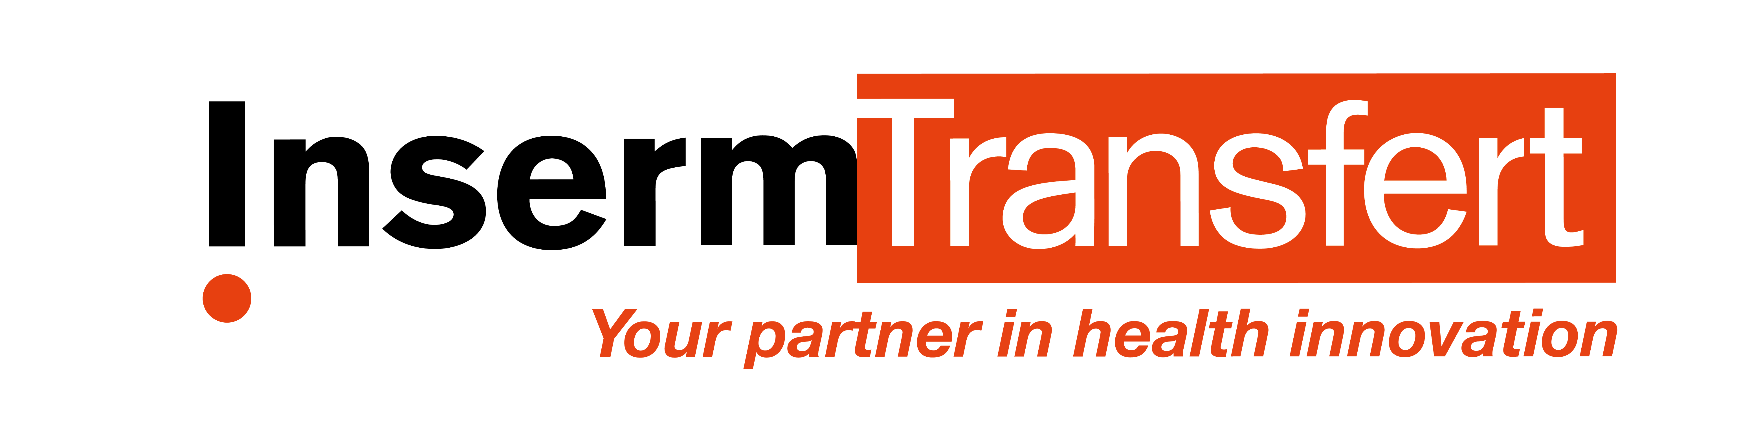
Take action to improve the health of all
Value creation activities which are bearing fruit
    2,492 patent family's portfolio
    152 new patent families in 2023
    An annual budget of €1.8 M to fund project
    maturation or proof of concept
    A maturation budget reaching €25.1 M invested
    in 419 projects since 2009
    €550.2 M industrial partnerships since 2010
    (patents, research contracts)
    ~ €25-30 M per year from licensing agreements
    Over 400 technologies and research tools available
    for licensing
    Strategic alliances with MSD Avenir, Astra Zeneca/MedImmune, Sanofi, AdBio Partners…
    10 startups created each year via Inserm Transfert
    (Inserm’s subsidiary)
    Partnerships with SATTs

Slide 22
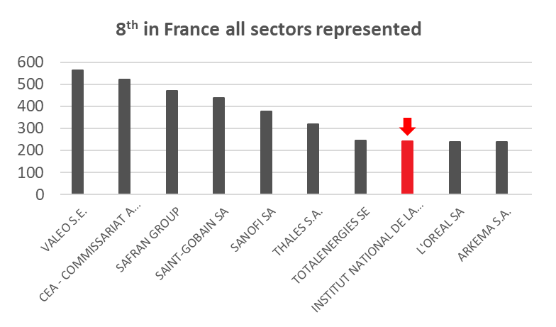
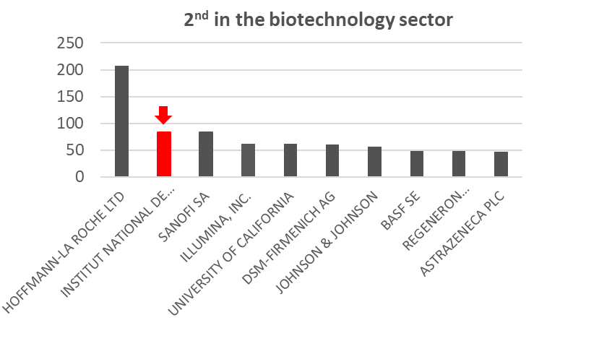
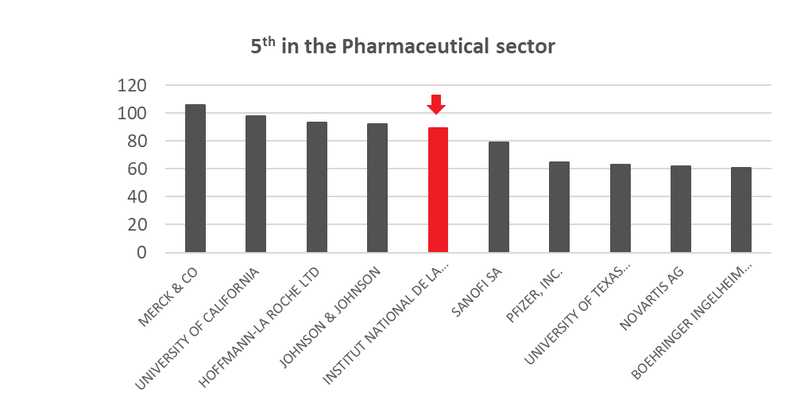
Take action to improve the health of all
Inserm & Inserm Transfert in EPO rankings
No. 5 European applicant in the pharmaceutical sector
No. 2 European applicant in the biotechnology sector (5th year)
No. 1 European research academic institution in the biomedical sector
2,492 patent families as of 31/12/2023

Slide 23









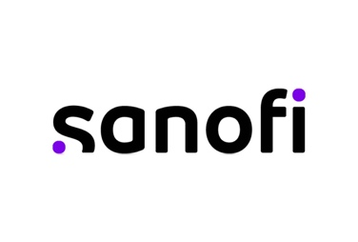

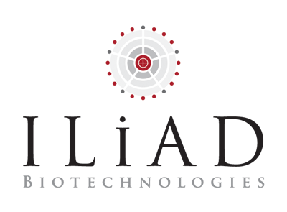











Take action to improve the health of all
Inserm Transfert: partnering with industries
Some of our industrial partners: privileged partner of major industrials, mid-size, SME, involved in human health, at the international level

Slide 24





































Take action to improve the health of all
Inserm spin-offs based on inventors as drivers
In-Cell-Art

Slide 25
Take action to improve the health of all
Major discoveries
  Since its foundation in 1964, Inserm has played a part in many key, historic medical advances, such as:
  the first prenatal diagnostic tests;
  understanding the HLA system and the ensuing immune reactions;
  the first in vitro fertilization;
  radiotherapy for cancer;
  the first skin graft;
  deep brain stimulation in the treatment of Parkinson’s disease;
  gene therapy in the treatment many diseases;
  innovative technologies like bioprinting, ultrasound, imaging organoids…
  the Nutri-Score informing on the nutritional quality of foods

Slide 26
Disseminate knowledge
for the benefit of all

Slide 27
Disseminate knowledge for the benefit of all
Our ethics committee to reflect on innovative research and to shed light on debates
Since 1999, Inserm ethics committee has focused on ethical questions in emerging areas of medical innovation
Publication of multiples notes on genome editing and participation in the creation of ARRIGE (Association for Responsible Research and Innovation in Genome Editing) in 2018
Launch in 2022 of Volrethics to define common international ethical rules to protect healthy volunteers in biomedical research
Think tanks on gender and health research, research on the human embryo, genomic medicine, neurotechnology in education, organoids and organs on chips…

Slide 28

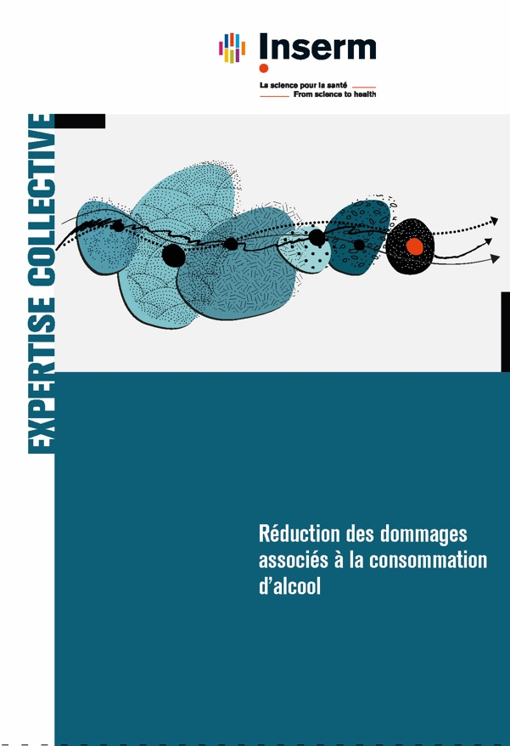
Disseminate knowledge for the benefit of all
Collective expert reviews and contribution to public health policy
Inserm fulfils its mission of expertise provision and knowledge transfer to decision-makers in the field of public health by providing the scientific insight required to take decisions on public health policy issues.

Slide 29
Disseminate knowledge for the benefit of all
Our work with patient organizations
Towards research in partnership with patient organizations and civil society collectives
Promote meetings and direct dialogue between researchers and collectives
Act for the structuring, coordination and animation of participatory research projects
Help to better take into account these projects in the assessment of researchers and structures
Facilitate access to scientific information for society

Slide 30







Disseminate knowledge for the benefit of all
Our presence in the service of public information
inserm.fr
  9,600,000
  visits
  154,000
  followers
  160,000
  followers
  52,000
  followers
  17,000 followers
  397,000
  followers
  24,500
  subscribers
  Live lectures and
  30’ Santé broadcast
  Public events
  Meetings on participatory research
  Canal Détox
  information videos and articles
  2.8 million participants and views
  166,500 views
  250 participants*
  273,000 views
* 2022 figures

Slide 31
#FromScienceToHealth

